Slide 1



MOOSIC
Your Mood.
Your Music.
19.09.2023
Capstone Project
Neuefische Data Practitioner

Slide 2




Meet the team - Rhythm Byte Engineers
Shahi
Christian
Grace

Slide 3
Intro
Idea and Vision

Slide 4



The Problem - Mood
59% of people often face difficulty in finding playlists according to their mood ¹
1 Survey by Anumeha Jain:
https://medium.com/@jainanumeha74/spotify-ux-research-case-study-68997acf20f1
‹#›

Slide 5
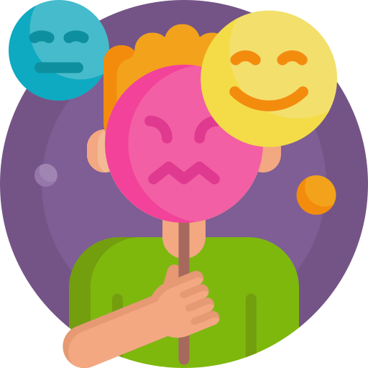

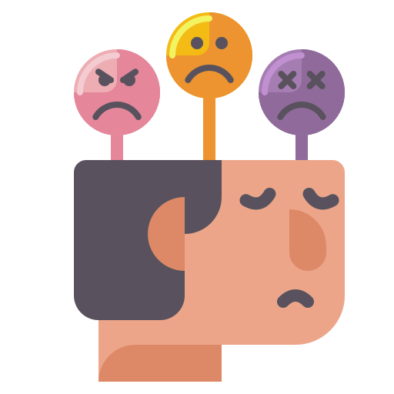

Mood Management
Participants of a study ², conducted by British psychologists, responded that they use music to express emotions and manage their mood.
2 Source: Why do we listen to music? A uses and gratifications analysis by Adam J. Lonsdale and Adrian C. North, p.120. Published in: British Journal of Psychology (2011), 102, 108–134

Slide 6


The Problem - Genre
Genre is also a key factor:
I’m listening to more than only my dominant genre!

Slide 7

Our Vision
For: Individuals, Music streaming platforms
Mood Management
Improve User Experience
Diverse Recommendations

Slide 8



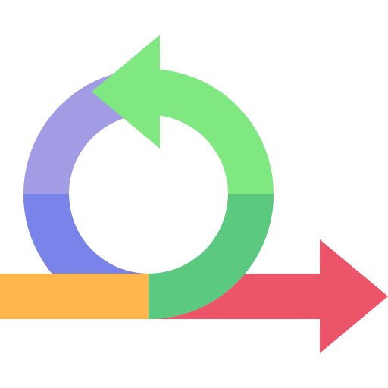









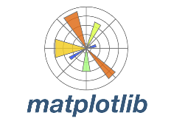






Our Tech Stack

Slide 9


The Data Set - Spotify 600k+ from Kaggle (1.7 Mio entries)
Artists.csv:
1.162.095 entries
Tracks.csv:
586.672 entries
Tracks from 1921-2020
Notes:
(Meta-information
Title: Spotify Dataset 1921-2020, 600k+ Tracks
Subtitle: Audio features of 600k+ tracks, popularity metrics of 1M+ artists
Source: Spotify Web API
Creator: Yamac Eren Ay
Release Date (of Last Version): April 2021
Dataset consists of tracks from the years 1922-2021)

Slide 10
EDA
How did we get our data

Slide 11


Getting to the right size
Cleaned
586.672
536.452
15.000
Entries
Samples

Slide 12
How an actual track now looks like
- Danceability
- Energy
- Valence
Track Metadata
Audio Features
Engineered Features
- Track ID
- Artist Name
- Genre
- Mood Goal

Slide 13
EDA
First insights

Slide 14
Feature Engineering - Genres
Genre combinations:
18.514
Unique subgenres:
7.033
Main Genres:
26

Slide 15
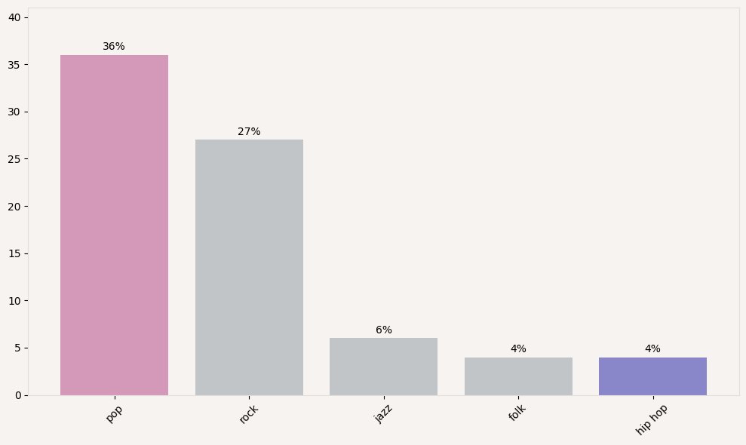
Distribution of the Top 5 Main Genres
Genres

Slide 16
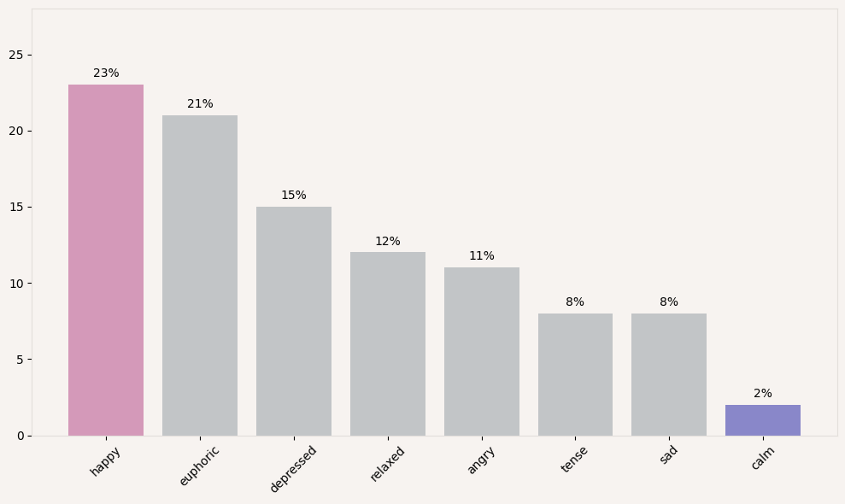
Distribution of the 8 Moods in our dataset
Mood Labels

Slide 17
How are the Genres distributed over the Moods?
Tense
pop
rock
metal
others
metal
Calm
pop
rock
jazz
folk
blues

Slide 18
Feature Engineering
Mood
Mood to Music Track

Slide 19
Mood Feature Engineering
What emotional and physical responses did the tracks evoke for a listener?
Valence:
Does the music track make you feel positive (pleasant)
or negative (unpleasant) ?
Energy:
Do you want to get active when listening to the music track
or do you want to chill?
References: A Connotative Space for Supporting Movie Affective Recommendation by Benini et al. ; A 12-Point Circumplex Structure of Core Affect by M. Yik, J. Russel & J. Steiger. :Emotion Label Enhancement via Emotion Wheel and Lexicon by Zeng et al.
‹#›

Slide 20
Mood Feature Engineering
Energy
Mood labelling validated using :
Modified Russell - Thayer’s model of affect
Plutchik’s wheel of emotion (color - to mood matching)
Elbow method
Eight (8) basic mood categories with umbrella affect terms words defined in the quadrants of the 2-D space
Tense
Q1 : Happy
High energy, High pleasant feelings (Valence)
Happy
Angry
Euphoric
Depressed
Calm
Sad
Relaxed
Valence
References: A Connotative Space for Supporting Movie Affective Recommendation by Benini et al. ; A 12-Point Circumplex Structure of Core Affect by M. Yik, J. Russel & J. Steiger. :Emotion Label Enhancement via Emotion Wheel and Lexicon by Zeng et al.

Slide 21


How does our recommendation system work?
Convert input into numerical representations
Get mood-genre clusters of tracks
Track to track similarity computation based on clustered music
N moosic tracks recommendations
Mood goal
Genre
03
05
User inputs Preferences
Vectorizes Preferences
Clustering
Similarity Computation
Moosic Playlist

Slide 22
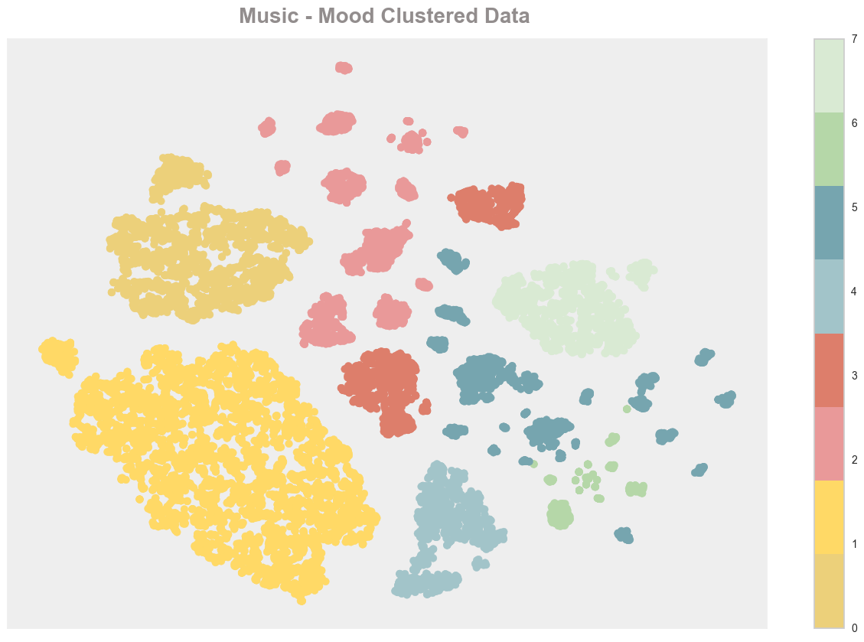
Evaluation results and error analysis
73%
Baseline
79%
Our Model

Slide 23
Moosic recommendations: Relaxed and Pop
Recommended Tracks | Associated Mood | Associated Genre
Wabash Cannonball | calm | folk
Magic Mirror | calm | folk
Jungle Blues | relaxed | jazz
Limbo Rock | euphoric | pop
Kolly Haga | sad | folk

Slide 24
Web Application
User Interface

Slide 25
MOOSIC
Your Mood.
Your Music.
19.09.2023
Capstone Project
Neuefische Data Practitioner
https://moosic.winderling.net

Slide 26
The End
Thank you
for your audience

Slide 27
Future Work
To be continued …

Slide 28
Future Work
Modelling:
Train on a bigger sample size
Put in all the tracks to see how the clustering will look (As of now clustering patterns change because tracks are randomly chosen for the sample).
Evaluation
We used the
Use other offline metrics like the Normalised mutual
Automation, Workflow Orchestration and other services
Airflow
Spark
Nifi/+Kafka
Docker + Kubernetes
Etc

Slide 29
2. Feature engineering - MOOD
Alternative approaches
Alternatively, music can be assessed on the three dimensions of "arousal", "valence", and "depth".^{[19]} Arousal reflects physiological processes such as stimulation and relaxation (intense, forceful, abrasive, thrilling vs. gentle, calming, mellow), valence reflects emotion and mood processes (fun, happy, lively, enthusiastic, joyful vs. depressing, sad), and depth reflects cognitive processes (intelligent, sophisticated, inspiring, complex, poetic, deep, emotional, thoughtful vs. party music, danceable).^{[19]} These help explain why many people like similar songs from different traditionally segregated genres.^{[1}
Danceability
Energy
Valence

Slide 30
Extra and Credits

Slide 31
Web App - Flowchart
Click “Try me”
View “Mood-Genre-Page”
Click “Show me Tracks”
Model makes predictions
View
“Results Page”
Click
“Track”

Slide 32
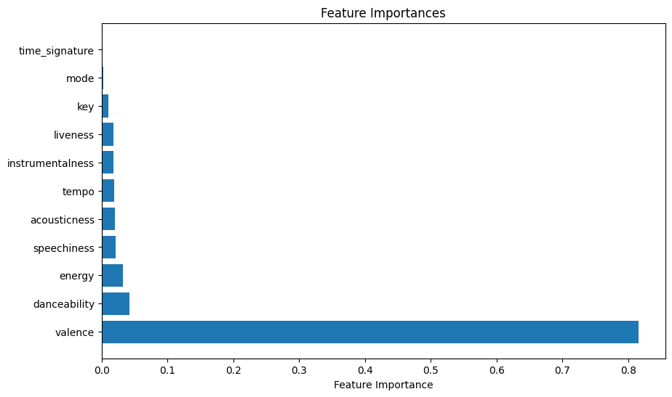
FAQ-Slide:
Feature importance for generating Mood classes

Slide 33
Genre
Mood
‹#›
Notes:
Intro to the Dataset and Highlights
We used the 600k+ dataset from spotify. It consists of two datasets: the tracks dataset and the artists dataset. Our goal is to use Mood and Genre as key features in our ML Model.So we needed to make sure to have all the features in our dataset. Lucky for us after combining the two datasets we had everything we needed to engineer our key features.
Meta-information
Title: Spotify Dataset 1921-2020, 600k+ Tracks
Subtitle: Audio features of 600k+ tracks, popularity metrics of 1M+ artists
Source: Spotify Web API
Creator: Yamac Eren Ay
Release Date (of Last Version): April 2021

Slide 34
Credits
Icons:
Slides 5-7:
<a href="https://www.flaticon.com/free-icons/listening" title="listening icons">Listening icons created by Freepik - Flaticon</a>
<a href="https://www.flaticon.com/free-icons/hip-hop" title="hip hop icons">Hip hop icons created by Flat Icons - Flaticon</a>
<a href="https://www.flaticon.com/free-icons/student" title="student icons">Student icons created by Iconjam - Flaticon</a>
<a href="https://www.flaticon.com/free-icons/emotions" title="emotions icons">Emotions icons created by Freepik - Flaticon</a>
<a href="https://www.flaticon.com/free-icons/mood" title="mood icons">Mood icons created by Flat Icons - Flaticon</a>
<a href="https://www.flaticon.com/free-icons/anger" title="anger icons">Anger icons created by wanicon - Flaticon</a>
<a href="https://www.flaticon.com/free-icons/speech-bubble" title="speech bubble icons">Speech bubble icons created by iconixar - Flaticon</a>
<a href="https://www.flaticon.com/free-icons/coordination" title="coordination icons">Coordination icons created by Freepik - Flaticon</a>
<a href="https://www.flaticon.com/free-icons/question-mark" title="question mark icons">Question mark icons created by Freepik - Flaticon</a>
<a href="https://www.flaticon.com/free-icons/angry" title="angry icons">Angry icons created by Freepik - Flaticon</a>
Credit: https://www.titanui.com/117730-150-tech-design-stack-icons-figma/ (slide 10)
<a href="https://www.flaticon.com/free-icons/machine-learning" title="machine-learning icons">Machine-learning icons created by Eucalyp - Flaticon</a>
‹#›

Slide 35
‹#›

Slide 36

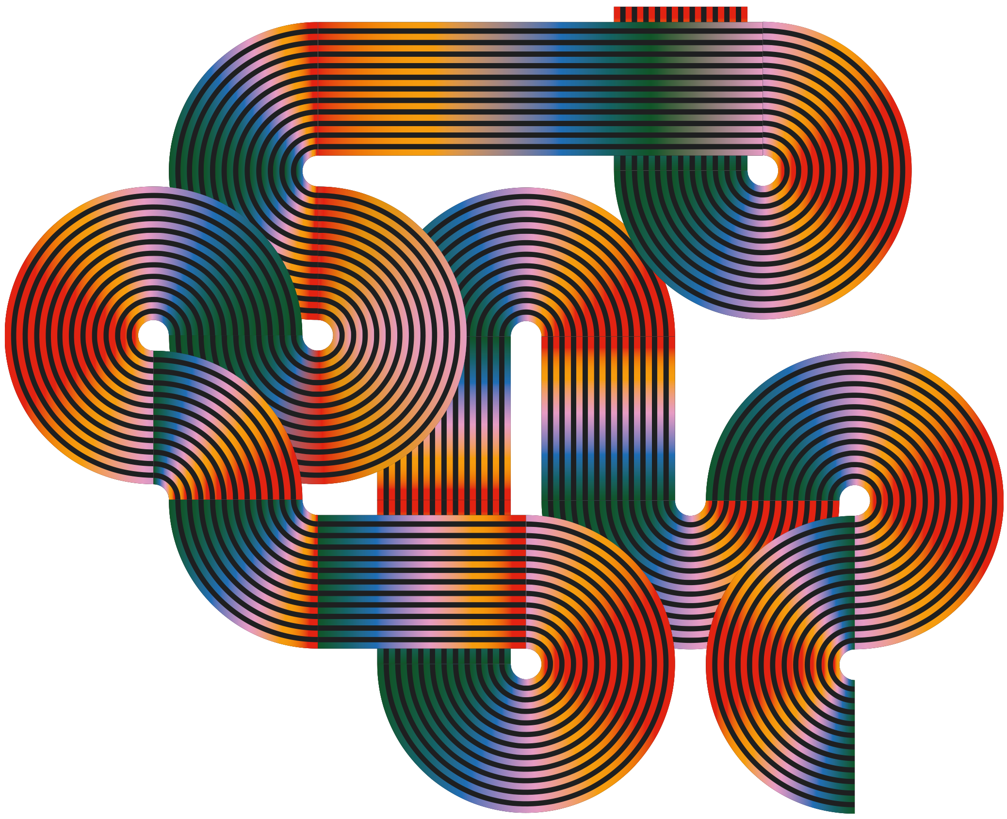

Alternative resources
Here’s an assortment of alternative resources whose style fits the one of this template:
Vectors
Instagram posts collection world music day celebration

